Slide 1


Slide 2


Agenda
Introduction about the project
Why I build this project
How this project works
What type of machine learning model that use in our project
Discuss about the python libraries that use in our project
What is SQLite3 database
What is python Flask framework
Why I used Flask framework instead of Django
What is web scraping
How training classes are works in our project
What I learn to build this project
What challenges I faced while build this project

Slide 3

Introduction about the project
Repo link:
https://github.com/ADITYADAS1999/MLH-Project_Repo-Major-League-Hacking-

Slide 4
Why I build this project
Main Goal
OpenSource
Less Complex
Cost Optimization

Slide 5

How this project works

Slide 6
What type of machine learning model that use in our project
Chatbot NLP engines contain advanced machine learning algorithms to identify the user's intent and further matches them to the list of available actions the chatbot supports
These AI-powered chatbots use a branch of AI called natural language processing (NLP) to provide a better user experience.
NLP is an applied artificial intelligence (AI) program that helps your chatbot analyze and understand the natural human language communicated with your customers

Slide 7
Discuss about the python libraries that use in our project
Python Library that use in project
Beautiful Soap
Flask
ChatterBot
Request
NLTK

Slide 8

What is SQLite3 database
SQLite is an embedded, serverless relational database.
Open source
Zero configuration and doesn't need to install.
Very convenient as it is less than 500kb in size which is significantly lesser than other relational database.

Slide 9
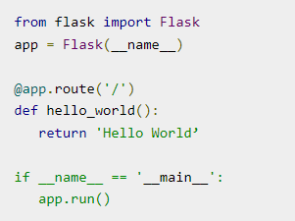

What is python Flask framework
Python Flask
.
.
.
.
.
.

Slide 10
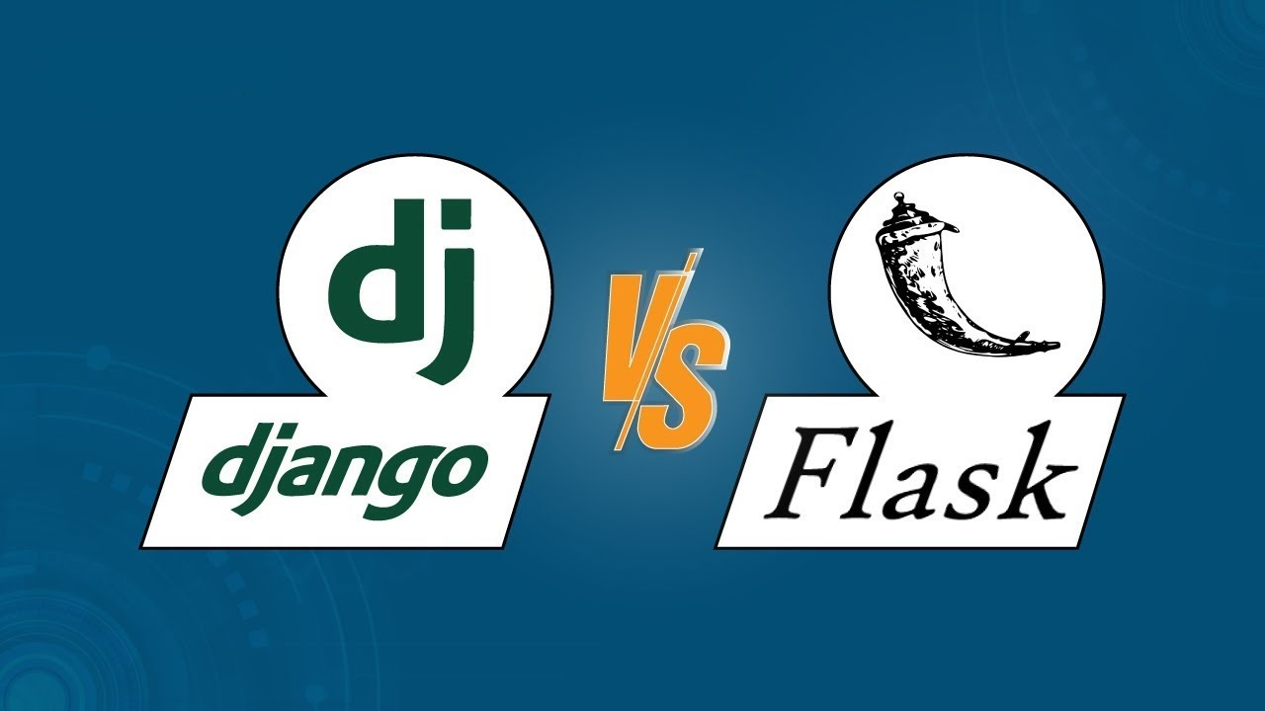
Why I used Flask framework instead of Django

Slide 11
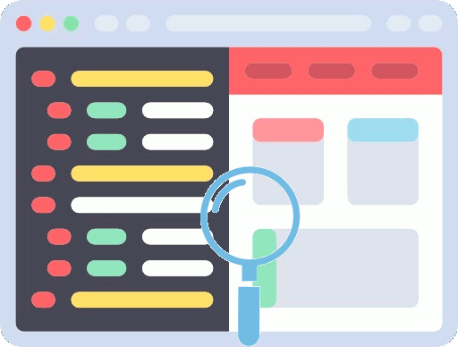
What is web scraping
Web scraping is the process of using bots to extract content and data from a website. Unlike screen scraping which is only copy the pixels displayed on screen, web scraping basically extract underlying HTML code and take all the data store in a database.
We use this concept in our project for extract the data or resources that is not familiar with chatbot.

Slide 12
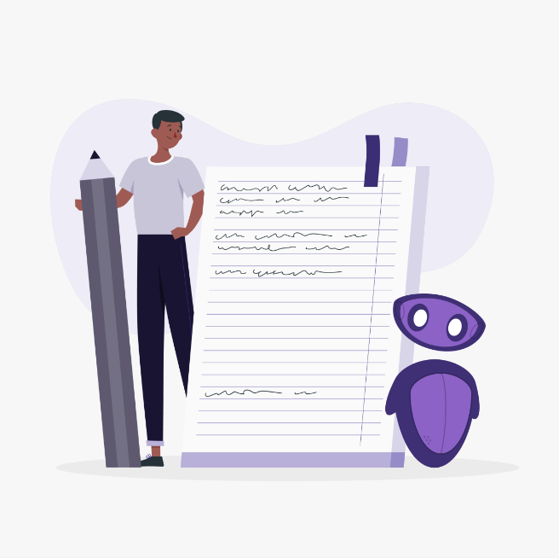

How training classes are works in our project
Training with list data
For this training process, we will need to pass in a list of statement where the order of each statement is based on its placement in a given conversion.
Chatterbot comes with a corpus data and utility that makes it easy to quickly train your bot to communicate.
Training with corpus data

Slide 13

What challenges I faced while build this project

Slide 14

What I learn to build this project

Slide 15


Follow Me on Twitter
@ADITYA90546170

